Slide 1

William Stallings Computer Organization and Architecture 8th Edition
Chapter 16
Micro-programmed Control

Slide 2
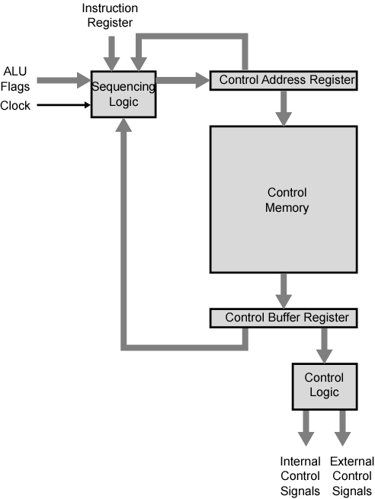
Control Unit Organization

Slide 3
Micro-programmed Control
Use sequences of instructions (see earlier notes) to control complex operations
Called micro-programming or firmware

Slide 4
Implementation (1)
All the control unit does is generate a set of control signals
Each control signal is on or off
Represent each control signal by a bit
Have a control word for each micro-operation
Have a sequence of control words for each machine code instruction
Add an address to specify the next micro-instruction, depending on conditions

Slide 5
Implementation (2)
Today’s large microprocessor
Many instructions and associated register-level hardware
Many control points to be manipulated
This results in control memory that
Contains a large number of words
co-responding to the number of instructions to be executed
Has a wide word width
Due to the large number of control points to be manipulated

Slide 6
Micro-program Word Length
Based on 3 factors
Maximum number of simultaneous micro-operations supported
The way control information is represented or encoded
The way in which the next micro-instruction address is specified

Slide 7
Micro-instruction Types
Each micro-instruction specifies single (or few) micro-operations to be performed
(vertical micro-programming)
Each micro-instruction specifies many different micro-operations to be performed in parallel
(horizontal micro-programming)

Slide 8
Vertical Micro-programming
Width is narrow
n control signals encoded into log₂ n bits
Limited ability to express parallelism
Considerable encoding of control information requires external memory word decoder to identify the exact control line being manipulated

Slide 9
Horizontal Micro-programming
Wide memory word
High degree of parallel operations possible
Little encoding of control information

Slide 10
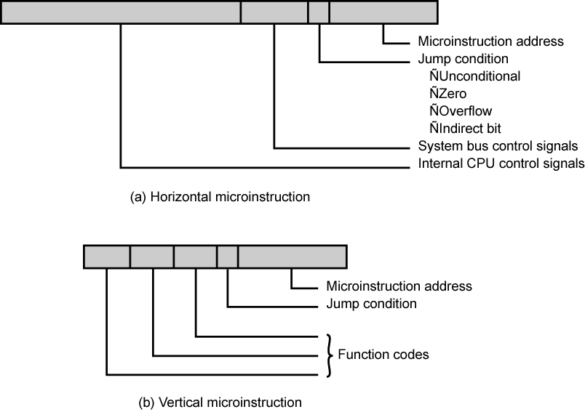
Typical Microinstruction Formats

Slide 11
Compromise
Divide control signals into disjoint groups
Implement each group as separate field in memory word
Supports reasonable levels of parallelism without too much complexity

Slide 12
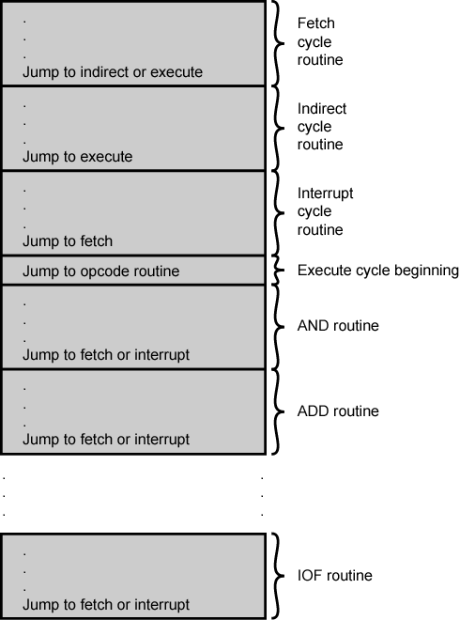
Organization of Control Memory

Slide 13
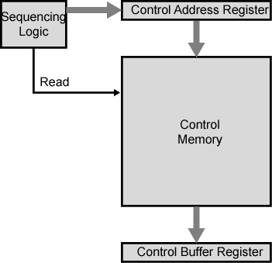
Control Unit

Slide 14
Control Unit Function
Sequence login unit issues read command
Word specified in control address register is read into control buffer register
Control buffer register contents generates control signals and next address information
Sequence login loads new address into control buffer register based on next address information from control buffer register and ALU flags

Slide 15
Next Address Decision
Depending on ALU flags and control buffer register
Get next instruction
Add 1 to control address register
Jump to new routine based on jump microinstruction
Load address field of control buffer register into control address register
Jump to machine instruction routine
Load control address register based on opcode in IR

Slide 16
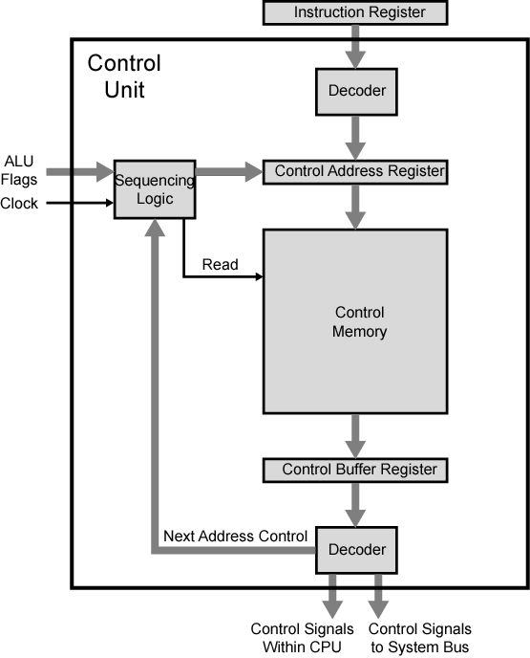
Functioning of Microprogrammed Control Unit

Slide 17
Wilkes Control
1951
Matrix partially filled with diodes
During cycle, one row activated
Generates signals where diode present
First part of row generates control
Second generates address for next cycle

Slide 18
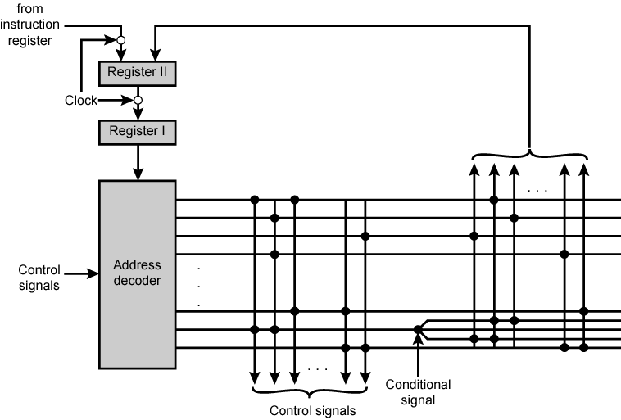
Wilkes's Microprogrammed Control Unit

Slide 19
Advantages and Disadvantages of Microprogramming
Simplifies design of control unit
Cheaper
Less error-prone
Slower

Slide 20
Tasks Done By Microprogrammed Control Unit
Microinstruction sequencing
Microinstruction execution
Must consider both together

Slide 21
Design Considerations
Size of microinstructions
Address generation time
Determined by instruction register
Once per cycle, after instruction is fetched
Next sequential address
Common in most designed
Branches
Both conditional and unconditional

Slide 22
Sequencing Techniques
Based on current microinstruction, condition flags, contents of IR, control memory address must be generated
Based on format of address information
Two address fields
Single address field
Variable format

Slide 23
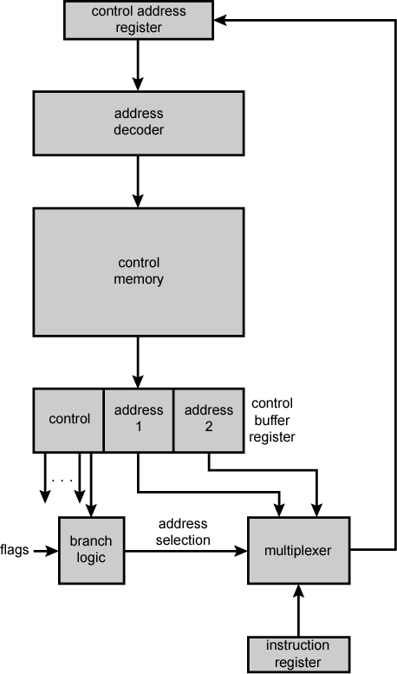
Branch Control Logic: Two Address Fields

Slide 24
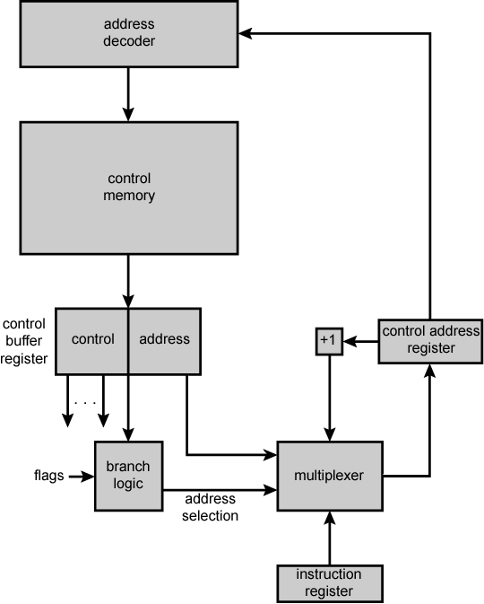
Branch Control Logic: Single Address Field

Slide 25
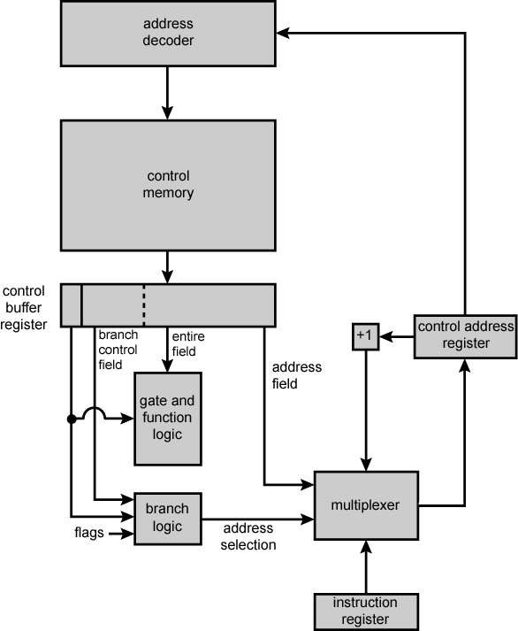
Branch Control Logic: Variable Format

Slide 26
Address Generation
Explicit | Implicit
Two-field | Mapping
Unconditional Branch | Addition
Conditional branch | Residual control

Slide 27
Execution
The cycle is the basic event
Each cycle is made up of two events
Fetch
Determined by generation of microinstruction address
Execute

Slide 28
Execute
Effect is to generate control signals
Some control points internal to processor
Rest go to external control bus or other interface

Slide 29
Control Unit Organization

Slide 30
A Taxonomy of Microinstructions
Vertical/horizontal
Packed/unpacked
Hard/soft microprogramming
Direct/indirect encoding

Slide 31
Required Reading
Stallings chapter 21

